Slide 1
Group 42 Gesture Recognition to Play music
0610032 林仲偉
0610032 彭楚鈞

Slide 2
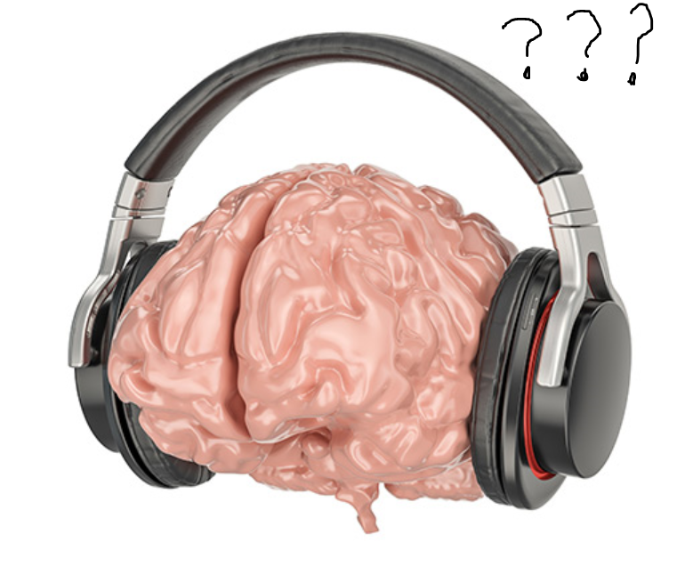
Inspiration
Machine learning on Stm32 sounds cool
Objective
Snapshot the picture took from camera
Input the image and verify it by network
Play a song according to some feature

Slide 3
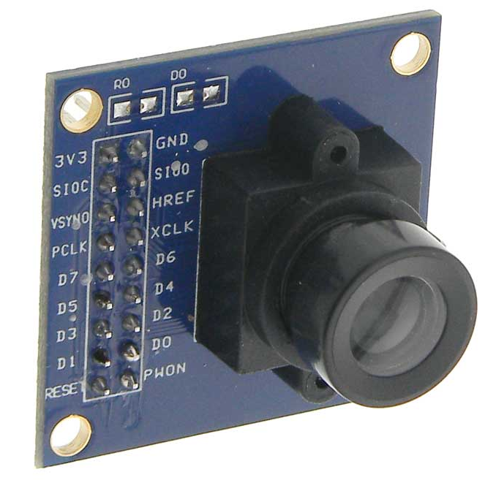
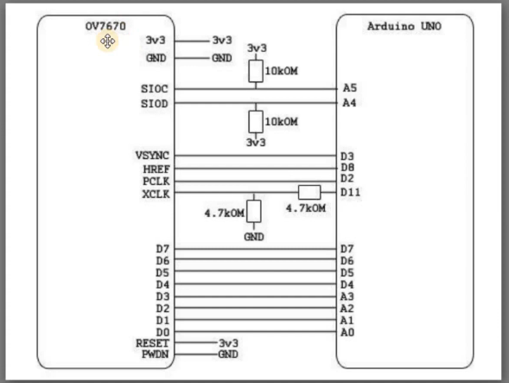
Requirement
Hardware
STM32L4-L476RG
OV7670: Camera (300$)
Software
Arduino
STM32CUBEMX
X-CUBE-AI
Pre-trained Neural Network
Support Keras, TensorFlow
User interface (Maybe)

Slide 4
Problem might encounter
How to load and pass image?
How to train? Which model to use?

Slide 5
Schedule
Input from OV7670 (not real time)
Load pre-trained model
Output Result: Show some stuffs
Side mission :
add more gesture (transfer learning)
Play music

